Slide 1
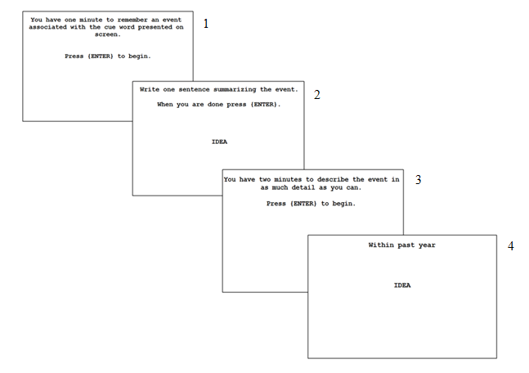
Age-Related Differences in Episodic Memory Retrieval in Autobiographical Memories
Heather Burkett, Simona Gizdarska, Meagan Griffin, & Lisa Emery
INTRODUCTION
RESULTS
Past research has shown that young adults produce more specific autobiographical memories than do healthy older adults (Addis et al., 2008; Piolino et al., 2009; Levine et al., 2002; Schlagman et al., 2009). Although older adults show less specificity of the memory retrieved, previous research has shown that general and semantic components are maintained (Piolino et al., 2010; Nilsson, 2003). Age differences in executive function are suggested to be partially responsible for this finding (Buckner & Hughes, 2004; Raz & Rodrigue, 2006). Additionally, high imagability cue words have shown to increase specificity in cue word retrieval paradigms for young to middle-aged adults (Williams et al., 1999). To our knowledge no study has investigated the role of the imagability of cue words in eliciting specificity in older adults. Given this gap in the research, we examined the use of both low and high imagability cue words to assess age differences in specificity in young and older adults. We predicted that high imagability words would decrease age differences in specificity, because of environmental support for memory retrieval. We also examined how executive function ability aided memory specificity, in particular, performance on the digit span backwards task (DSB).
Procedure
QUESTION #2: Are age-related differences in specificity correlated with executive function ability?
Performance on DSB was highly correlated with specificity elicited by both low and high imagability words, but only for Older Adults. Young Adults’ performance on DSB was not strongly correlated with specificity for either low or high imagability words.
ANSWER: YES.
 | Imagability Type
Age Group | Low | High
Young | -.09 | -.11
Old | .57 | .40
Participants also completed a battery of questionnaires and cognitive tests, including a measure of depression (DASS-21) and working memory capacity/executive function (Digit span backwards).
This is consistent with past research from our lab, which showed that for young adults, working memory capacity was only correlated with episodic future thought specificity, and not autobiographical memory specificity (Hill & Emery, 2013).
QUESTION #1: Does the imagability of the cue word influence the size of the age difference in specifcity?
There was an effect for Specificity, F(1,44) = 5.92, p = .02, and there was an effect for Age Group when considering Specificity, F(1, 44) = 4.55, p = .04.
DASS-21 scores were included in the analyses as a covariate.
CONCLUSIONS
ANSWER: YES.
METHOD
Older Adults’ memories were less specific for both high and low imagability words.
Overall, highly imageable words do not appear to assist Older Adults in retrieving specific autobiographical memories. This is inconsistent with our predictions, and poses new questions in autobiographical memory retrieval for older adults.
Given that Digit Span Backwards is highly correlated with specificity for Older Adults, and not Young Adults, it is possible that age differences in executive function may be related to this decrease in specificity.
Participants
Data collection for this study is ongoing; presented data is from participants who completed all components of the study. This includes:
26 young adults (ages 18 - 25; M = 19.3 years)
21 older adults (ages 64 - 85; M = 74.2 years)
Participants were shown 10 cue words (5 high imagability, 5 low imagability).
Cue words were balanced for frequency, valance, and arousal.
WORD | IMAGABILITY
ADVANTAGE | LOW
CHANCE | LOW
IDEA | LOW
OPINION | LOW
TRUTH | LOW
CANDY | HIGH
FRIEND | HIGH
ROCK | HIGH
TOY | HIGH
TRUCK | HIGH
Reprints may be obtained at agelabs.appstate.edu

